Slide 1
A Real Time Application to Identify Alcoholics from ECG Signals
Akarsh N Kolekar (1PI13EC009) Guide: Dr. b Niranjana Krupa
Apoorv Vatsal (1PI13EC017)
Rakshith Vishwanatha (1PI13EC075)

Slide 2
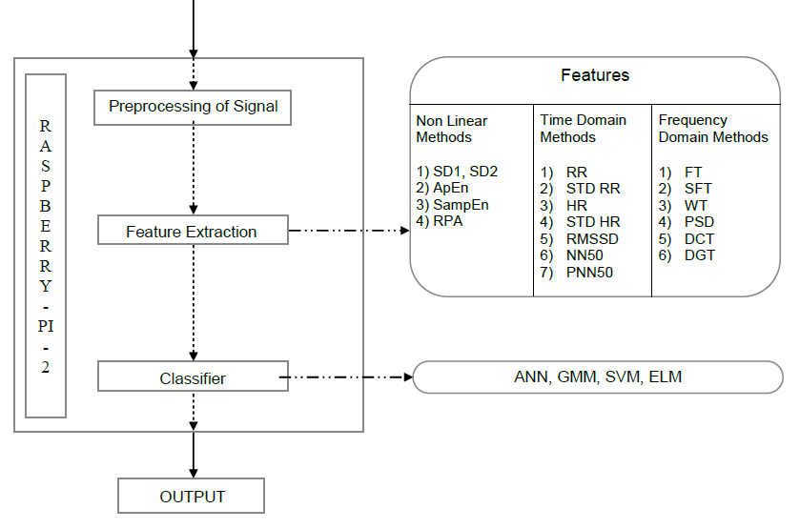
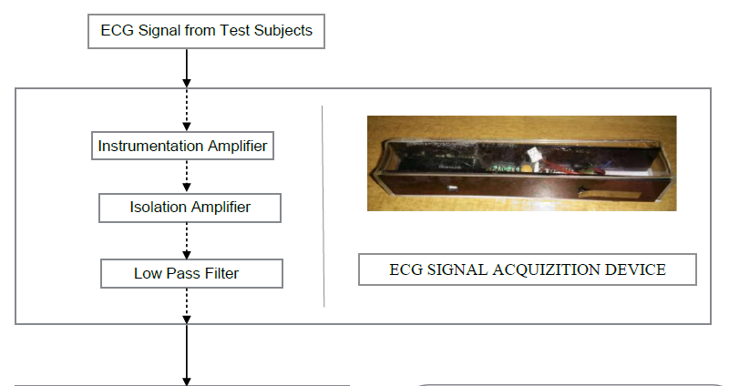
Overall Flow/Methodology
1) PSD

Slide 3
Work Done By First Review
RAKSHITH
Time domain feature extraction
Non linear feature extraction
APOORV
Raspberry pi setup
Frequency domain feature extraction
AKARSH
Circuit design/simulation
Introduction to ELM classifier

Slide 4
Work Done By Second Review
RAKSHITH
Implemented SVM Classifier on MATLAB
Started Porting Code onto Python
Started work on Circuit and interface with Raspberry-Pi
APOORV
Converted all MATLAB toolbox operations to MATLAB scripts
Worked on AR Modelling. Started work on ARX.
Started work on Circuit and interface with Raspberry-Pi
AKARSH
Implemented ELM Classifier on MATLAB
Implemented ELM Classifier on Python
Started work on Circuit and interface with Raspberry-Pi

Slide 5
Work Done By Third Review
RAKSHITH
Trained and tested SVM for unbiased dataset with crossvalind()
Feature reduction techniques -- PCA and Combinational Selection
Completed porting time domain, non-linear feature extraction MATLAB code to Python
Worked on designing filters for ECG sensor
APOORV
Worked on ARX modeling of ECG signals
Interfaced sensor with Raspberry-Pi to obtain CSV file at correct sampling rate
Worked on implementing ECG sensor and verifying operation of AD8232
AKARSH
Understood Meta Cognitive Learning Algorithm for an ELM Classifier
Worked on implementing ECG sensor and verifying operation of AD8232

Slide 6
Work Done Since Last Review
RAKSHITH
Corrected SVM code
Obtained a 2D map of common C and sigma used – Accuracy is 77% - 88%
Calculated Confusion matrix
Classified ECG signal using SVM
APOORV
Finished implementing ARX
Gave higher accuracies for SVM and ELM
Recorded ECG signal and extracted features
Found work around for wavelet transform on Python
AKARSH
Corrected ELM kernel – resulted in approx. 15 odd neurons, Accuracy is 88% – 94%
Calculated Confusion matrix
Classified ECG signal using elm

Slide 7
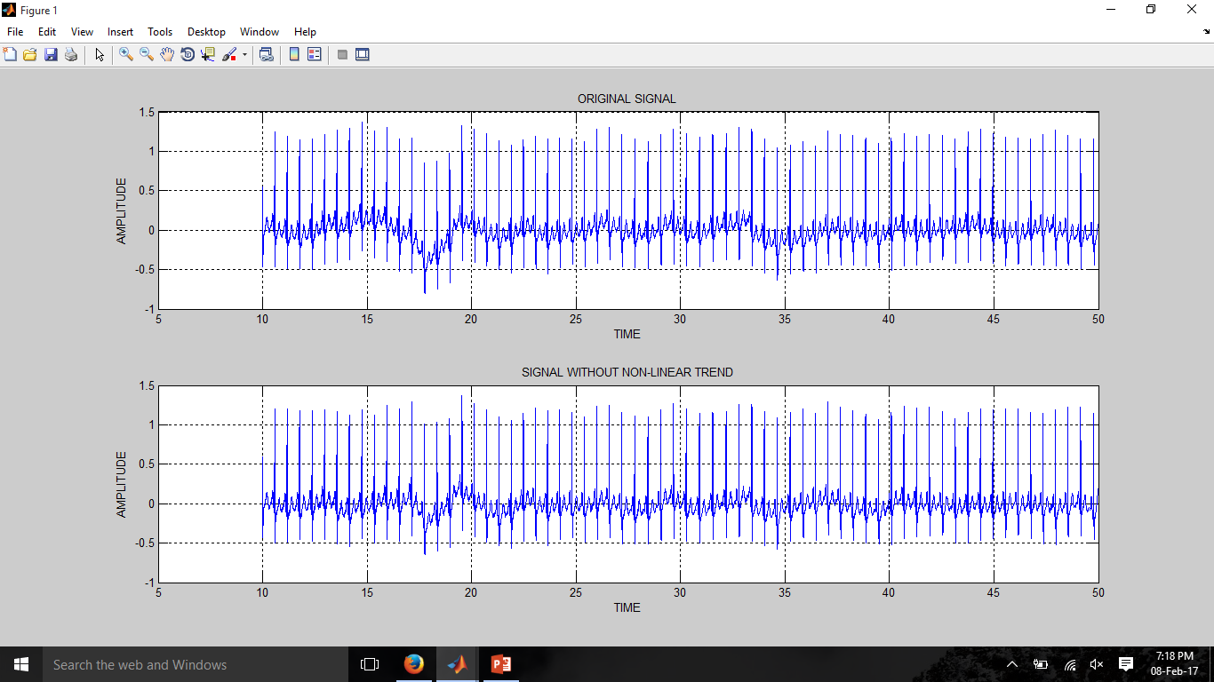
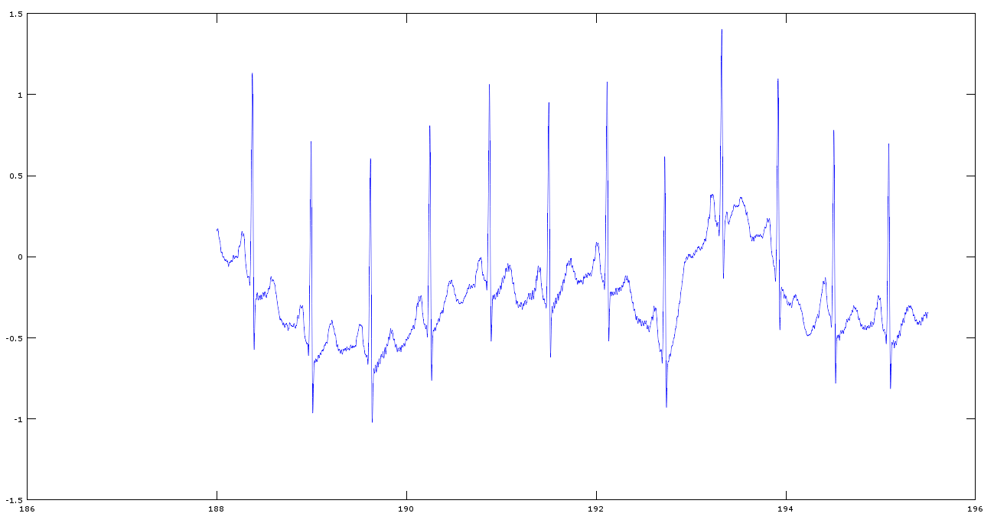
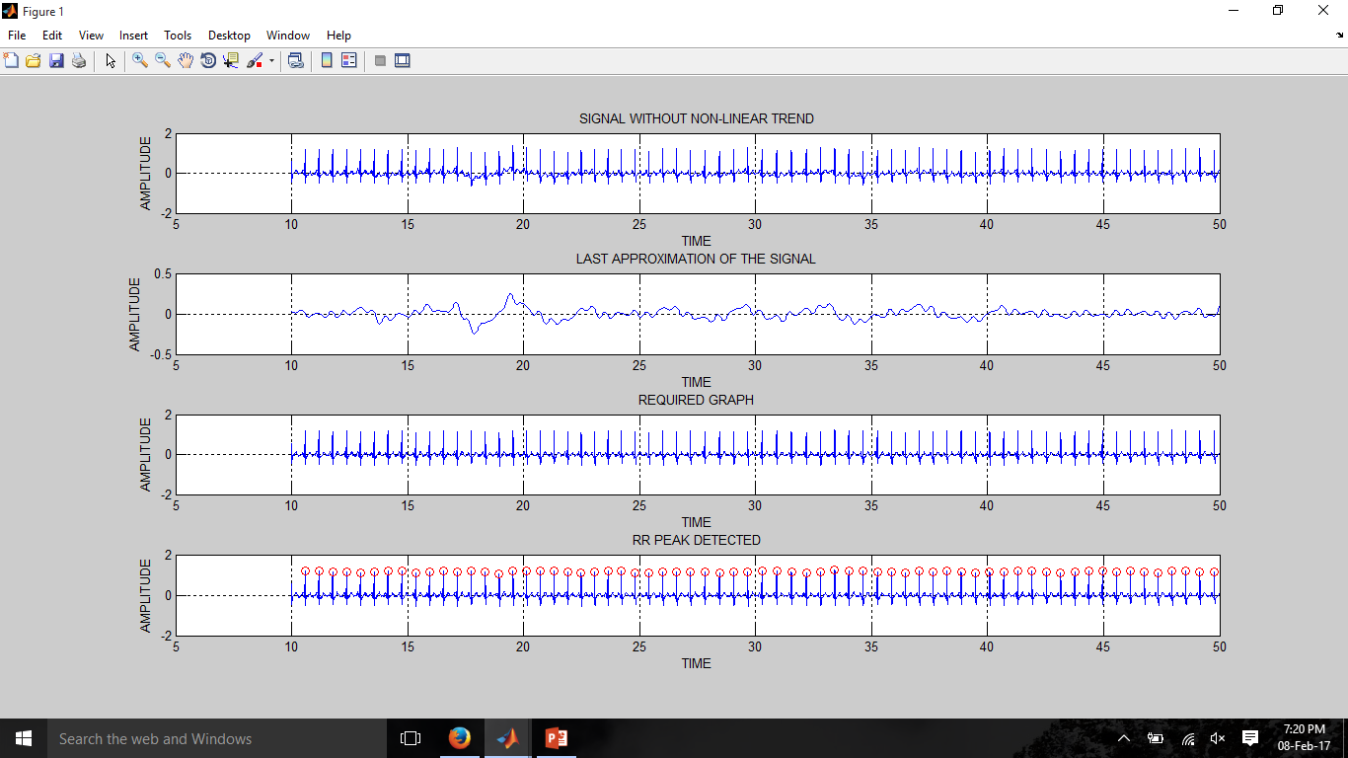
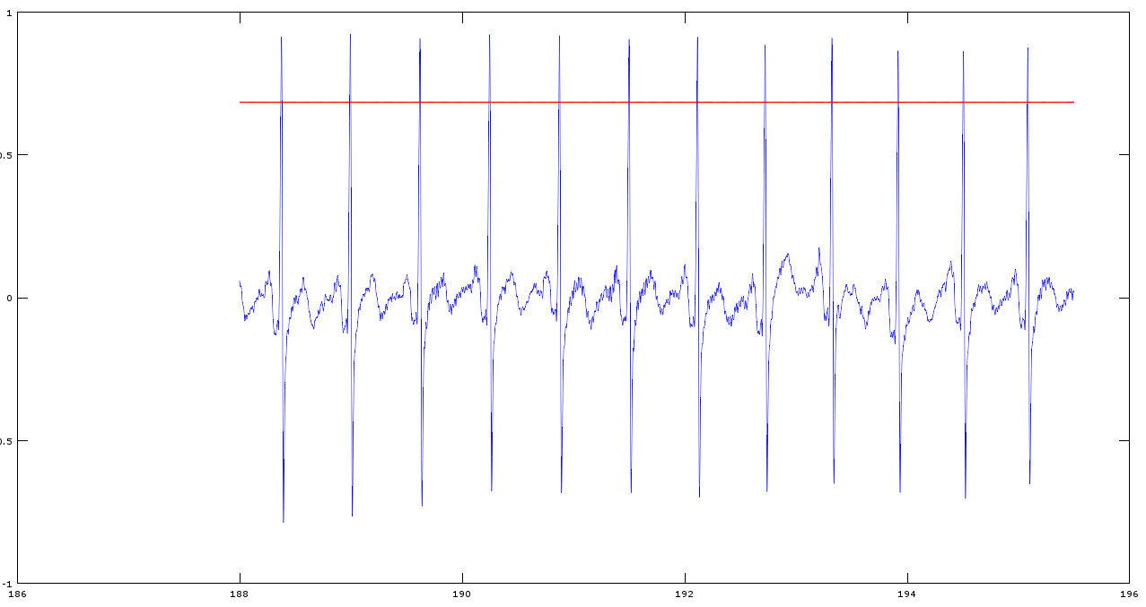
Intermediate Graphs and Outputs

Slide 8
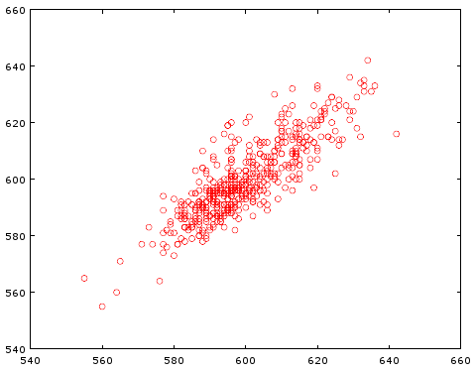
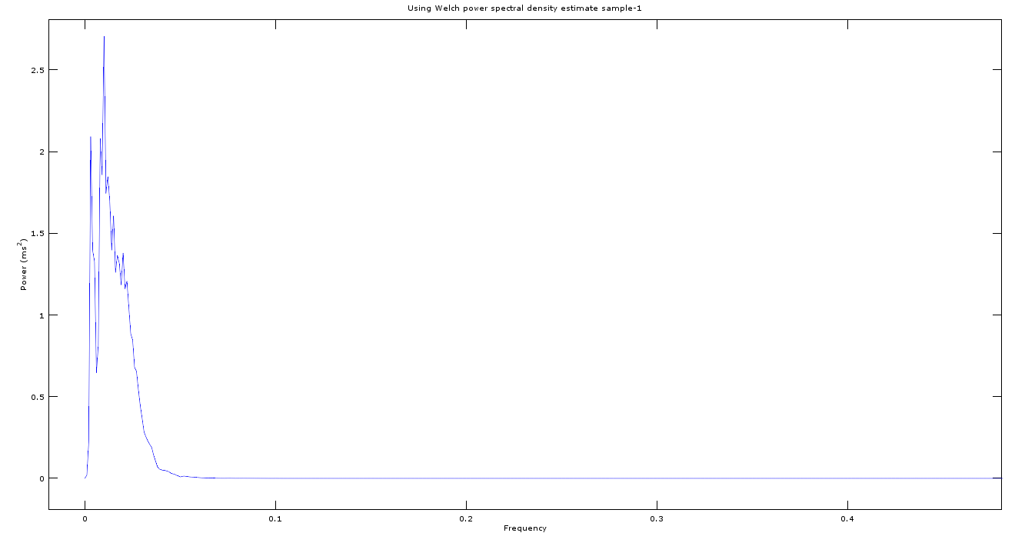
Intermediate Graphs and Outputs

Slide 9
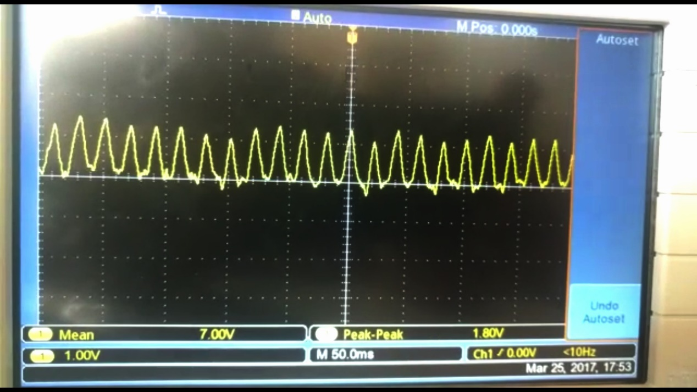
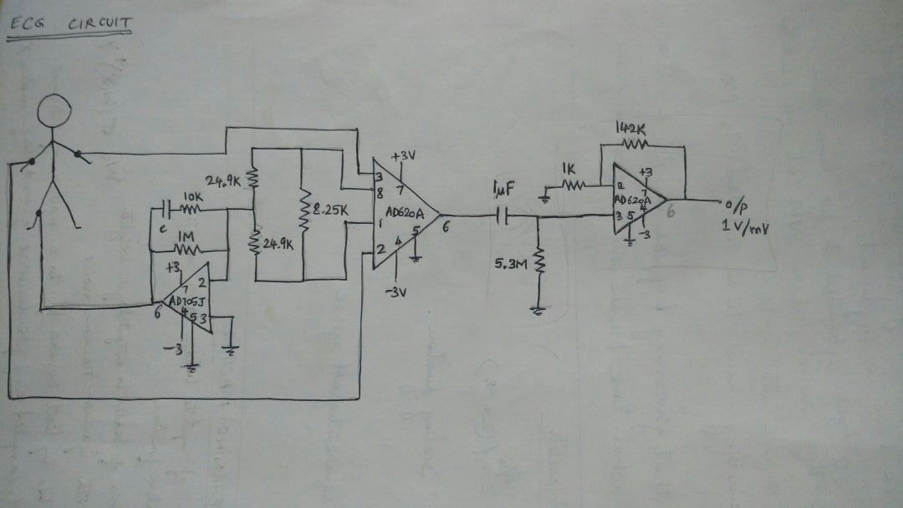
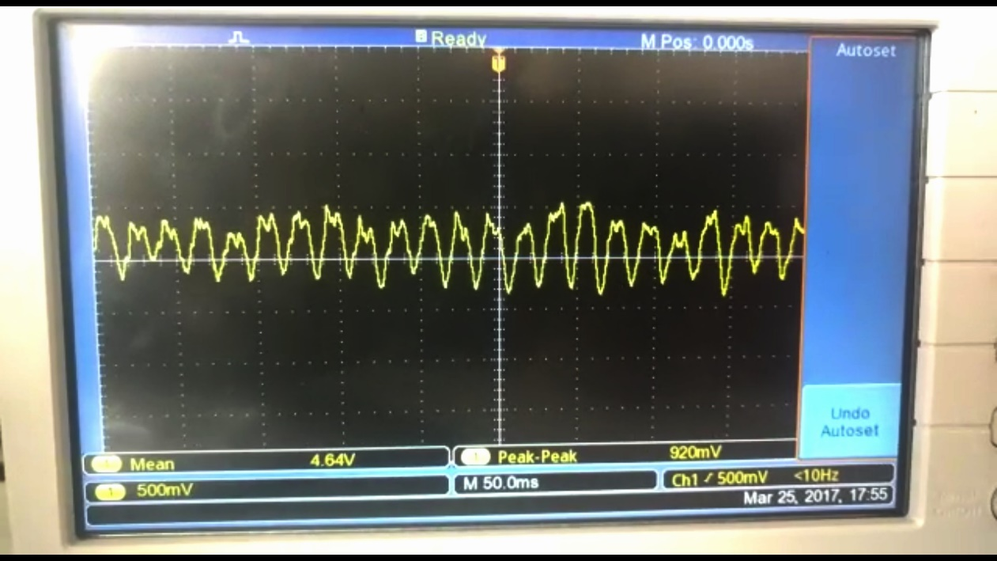
Multiple Designs for Circuit

Slide 10
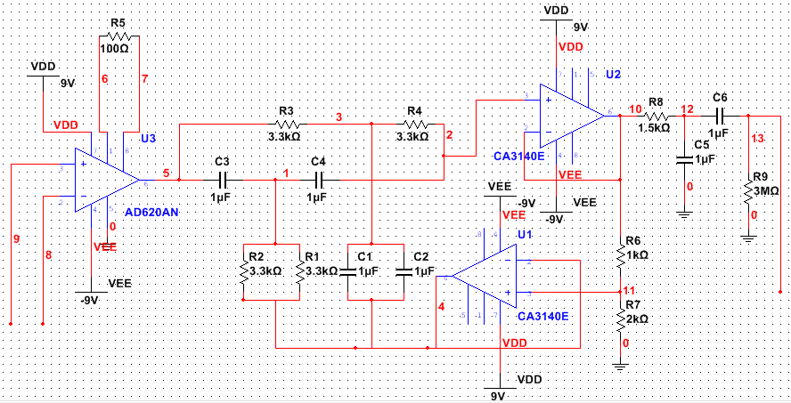
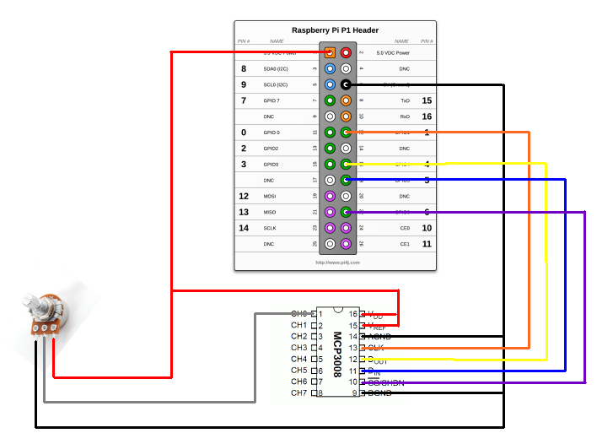
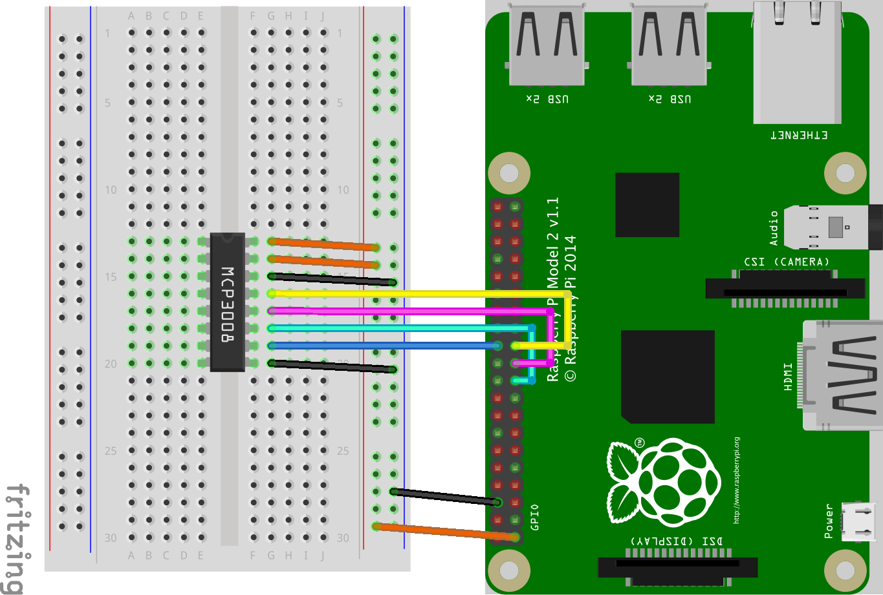
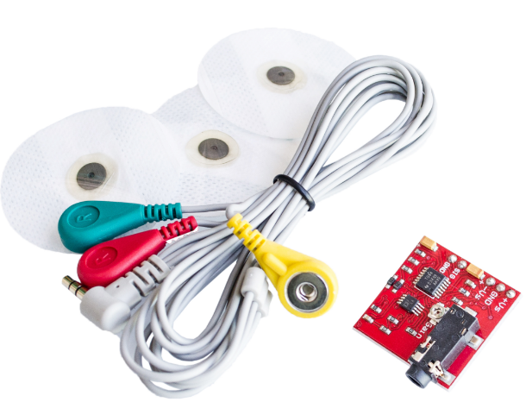
Multiple Designs for Circuit

Slide 11
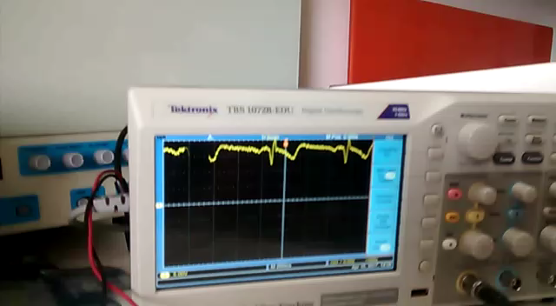
ECG Signal Capture

Slide 12
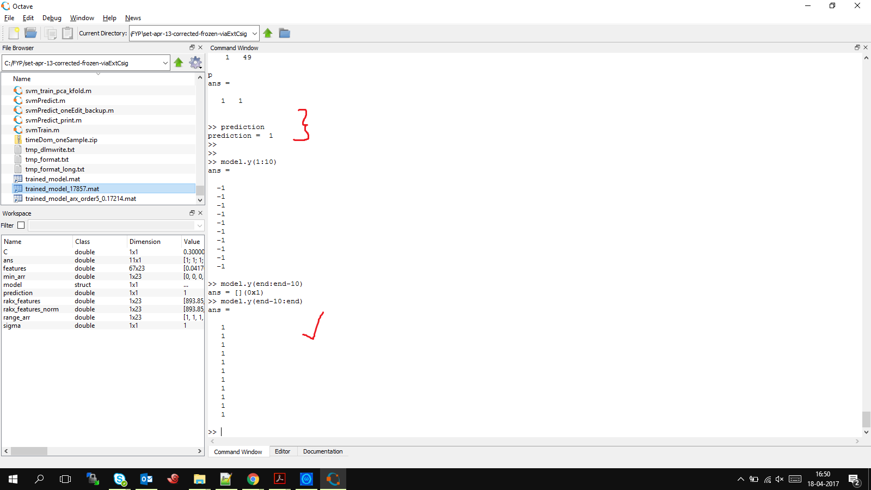
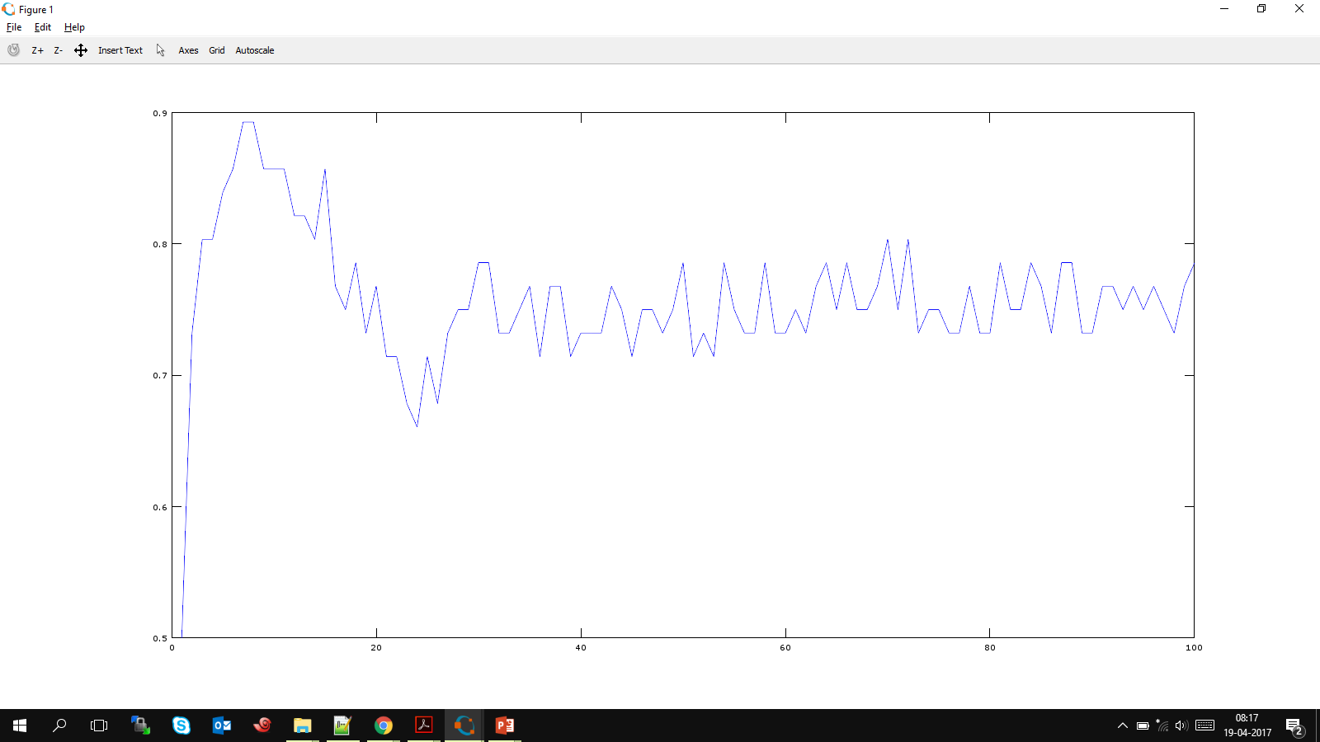
Outputs Since Last Review

Slide 13
TARGETS FOR THE EXTERNAL REVIEW
RAKSHITH
Optimize features required using combnk() and compare SVM and ELM
Complete the Report
APOORV
Complete the frequency domain feature extraction Python code
Integrate hardware and python code on the Raspberry Pi to make a complete system
Complete Report
AKARSH
Optimize features required using combnk() and compare SVM and ELM
Complete the Report

Slide 14
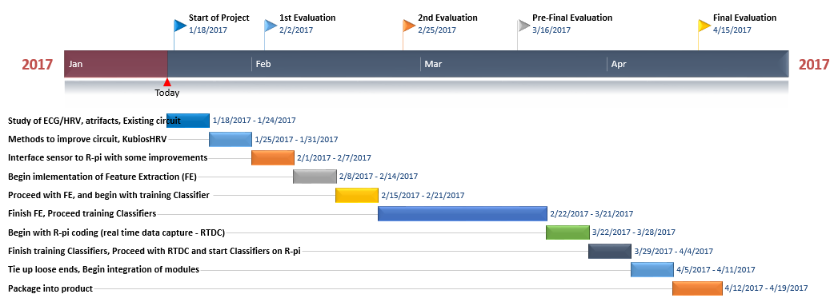
TIMELINE
On schedule as per expected timeline

